Slide 1


Breakout 2
Patient Centred Safety Systems
Helen Hughes, CEO Patient Safety Learning
Prof Lourda Geoghegan & Kieran McAteer DoH

Slide 2
NIPSO Patient Safety Conference
Designing Patient Safety Centered Systems
Helen Hughes, Chief Executive
Wednesday 20 March 2024

Slide 3

Agenda
Patient Safety Learning
  who are we & what do we do
Patient safety: the problem and impact
Why does avoidable harm persist?
What are healthcare leaders doing to address avoidable harm?
How Patient Safety Learning is contributing to safer care
PSIRF and NI SAI replacement
Reflective questions

Slide 4
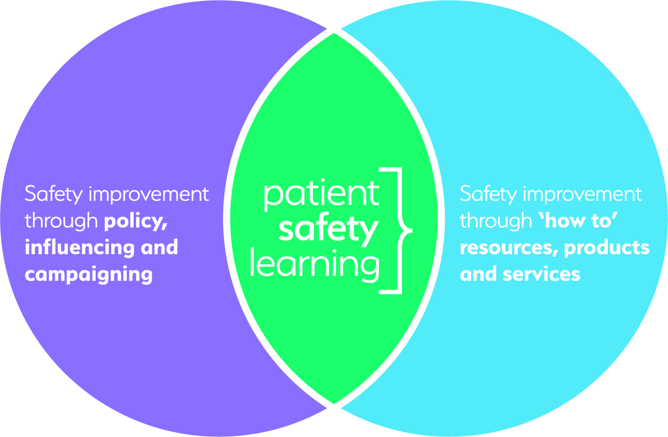
Patient Safety Learning
Founded 2018
A charity and independent voice for patient safety
Listening, learning and promoting the voice of the ‘patient safety front line’
Mission & Purpose
  To transform how health & social care
  organisations think & act in regard
  to patient safety
  Patient safety as a core purpose

Slide 5
Agenda
Patient Safety Learning
  who are we & what do we do
Patient safety: the problem and impact
Why does avoidable harm persist?
What are healthcare leaders doing to address avoidable harm?
How Patient Safety Learning is contributing to safer care
PSIRF and NI SAI replacement
Reflective questions

Slide 6
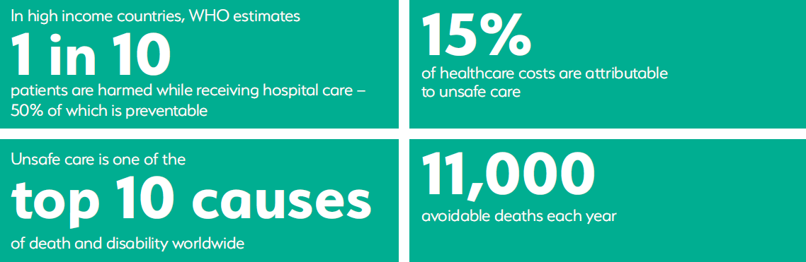
Scale and impact of avoidable harm in healthcare
Patients assume patient safety is a priority until they experience avoidable harm
Despite the efforts & good work of many people, unsafe care continues to persist
RCEM estimated at least 300-500 excess deaths per week – Jan 2023
HSJ analysis of NHS data, 30k excess deaths a year in ED – Nov 2023
Have we normalised an unsafe system? What are the NI stats?

Slide 7
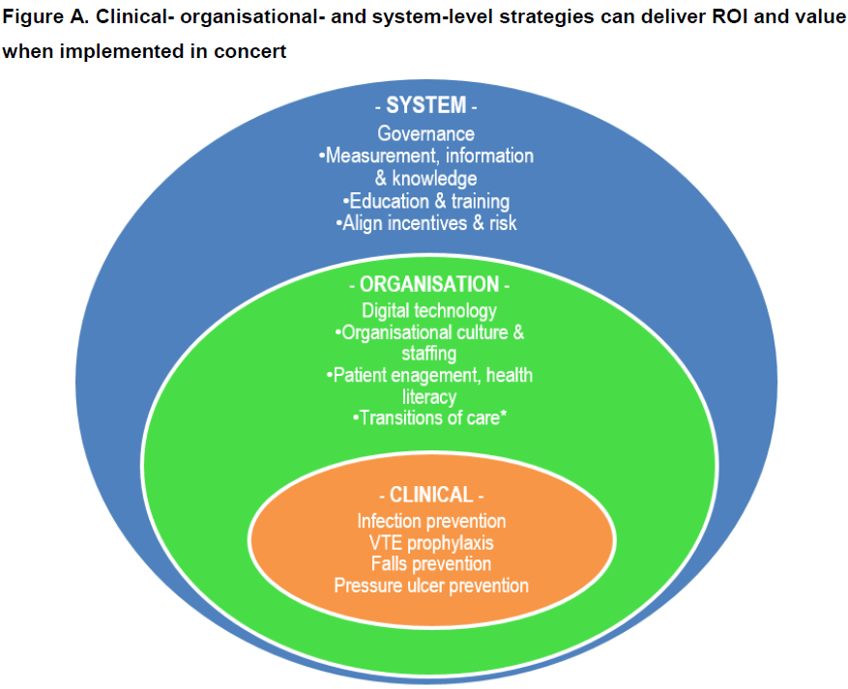
OECD report on the economics of patient safety
40% patient safety issues in primary care
Patient safety burden of disease
  More than 7 million hospital admissions every year
  At least 6% of all hospital beds
  $384 billion cost to the global economy in 2022, G20
World Patient Safety Day 2024
  Diagnostic error
OECD, The Economics of patient safety: From analysis to action, October 2020 and G20 Health and Development Partnership, The Overlooked Pandemic: How to transform patient safety and save healthcare systems, March 2021.

Slide 8
Agenda
Patient Safety Learning
  who are we & what do we do
Patient safety: the problem and impact
Why does avoidable harm persist?
What are healthcare leaders doing to address avoidable harm?
How Patient Safety Learning is contributing to safer care
PSIRF and NI SAI replacement
Reflective questions

Slide 9
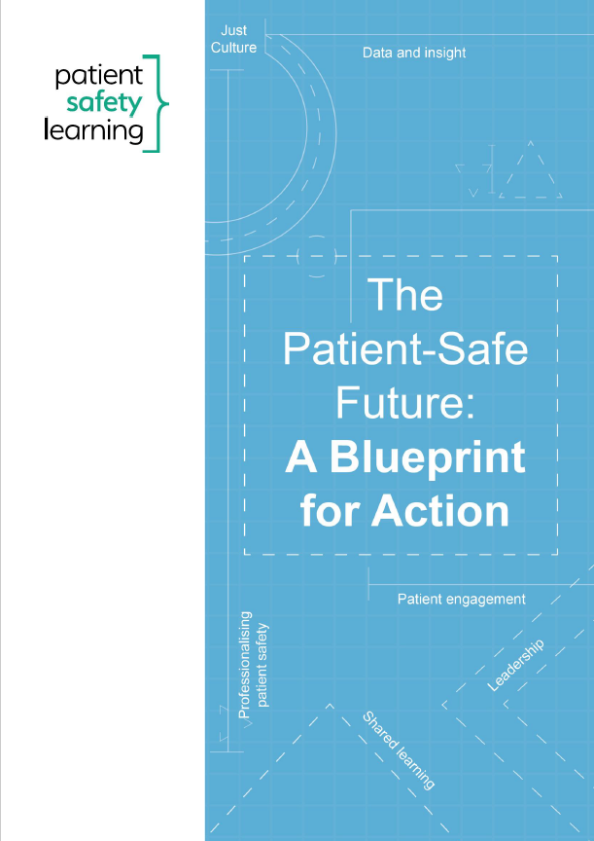
Why does avoidable harm persist?
Safety is one priority of many
Few safety standards
Not designing safety systems
Blame culture & fear
Patients not engaged
Lack of leadership
Failure to learn & act
Healthcare needs to operates as an effective safety management system; safety as a core purpose

Slide 10

Patient safety must become a core purpose in...
Policy-making
Service commissioning & planning
Standards & good practice governance
Service provision
Professional regulation
System regulation
Patient & family engagement
Business and financial planning
...across health and social care, a safety management system approach

Slide 11

Safety Management System report
The purpose of an SMS is to ensure that an industry achieves its business and operational objectives in a safe way and complies with the safety obligations that apply to it
HSSIB suggests:
  Mapping current safety management activities to SMS principles
  Identify opportunities for improvement
  Determining if the way safety is managed would be usefully guided by SMS principles
  Further understanding how an accountability framework could support an SMS approach
  Understanding how safety issues & risks are identified & managed through an SMS approach
HSSIB recommends
  NHSE explores & develops SMS with a co-ordination group
  CQC’s effectively assesses safety management activities
1. HSSIB, Safety management systems – an introduction for healthcare, 18 October 2023 and HSSIB, Video: Introduction to safety management systems, 16 October 2023.

Slide 12
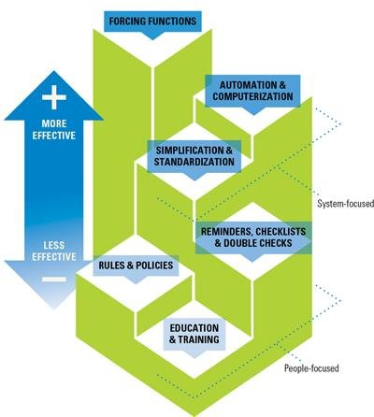
Hierarchy of Improvement Intervention Effectiveness
Most effective: system focused
Forcing functions
Automation & computerisation
Simplification & standardisation
Least effective: people focused
Checklists
Rules and policies
Education and Training
Need to move from people-focused to system-focused interventions
Notes:
https://www.google.com/url?sa=i&url=https%3A%2F%2Fwww.researchgate.net%2Ffigure%2FHierarchy-of-Improvement-Intervention-Effectiveness_fig2_332751505&psig=AOvVaw0d7Ch9prwrDNJNlJLYy_pA&ust=1605289312900000&source=images&cd=vfe&ved=0CA0QjhxqFwoTCPj8sezG_ewCFQAAAAAdAAAAABAN

Slide 13
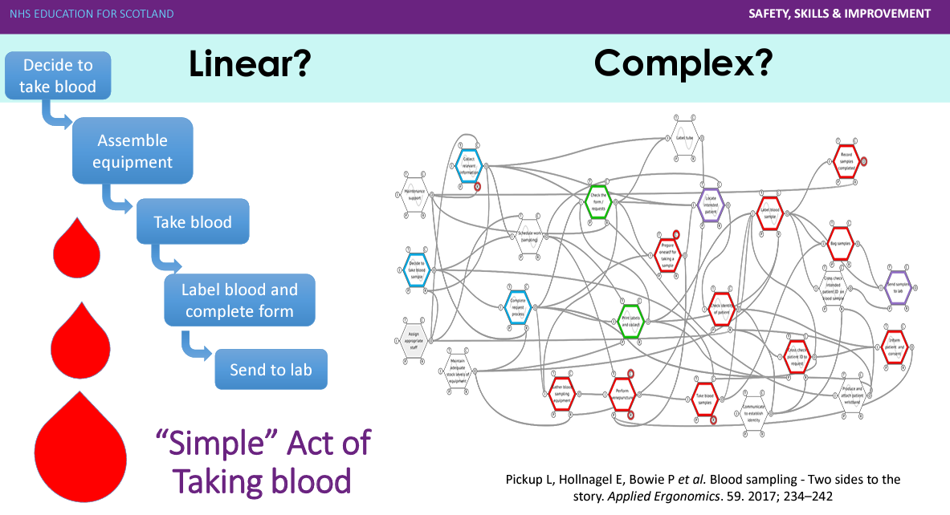
Health care is complex: ‘the messy reality’

Slide 14
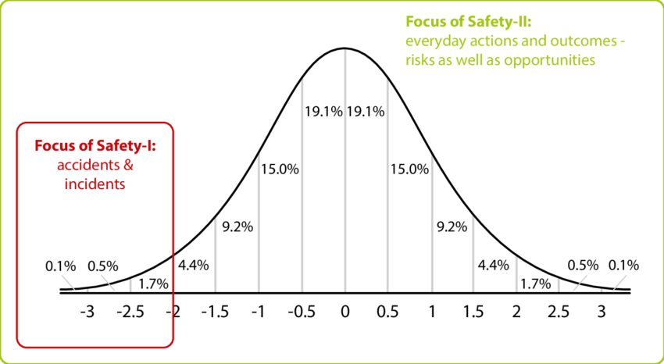
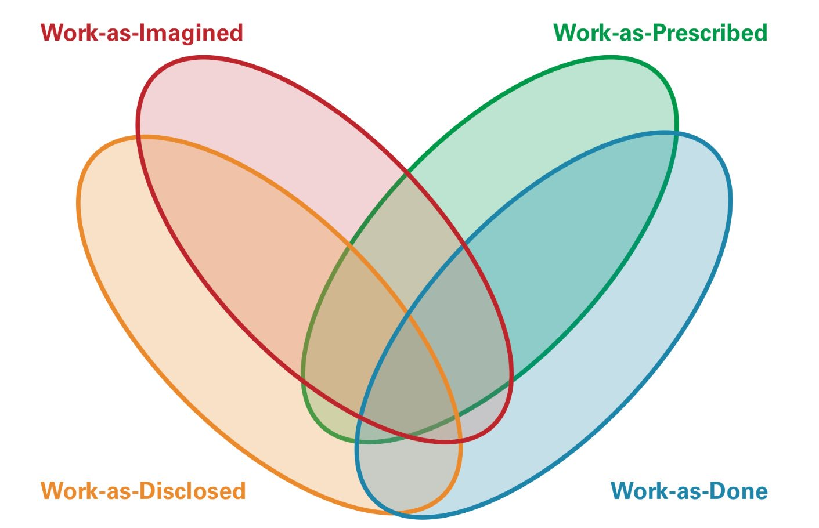
Patient safety isn’t just about incidents, we need to design for safety not just address harm

Slide 15
Agenda
Patient Safety Learning
  who are we & what do we do
Patient safety: the problem and impact
Why does avoidable harm persist?
What are healthcare leaders doing to address avoidable harm?
How Patient Safety Learning is contributing to safer care
PSIRF and NI SAI replacement
Reflective questions

Slide 16
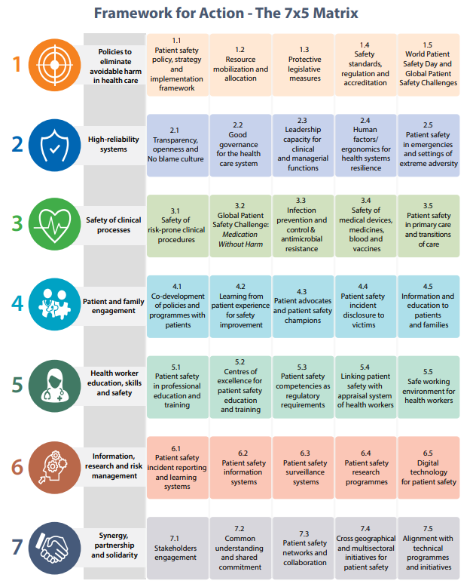
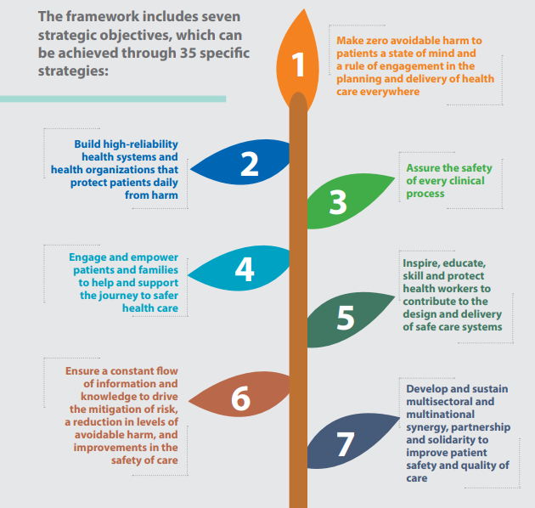
WHO Global Patient Safety Action Plan

Slide 17
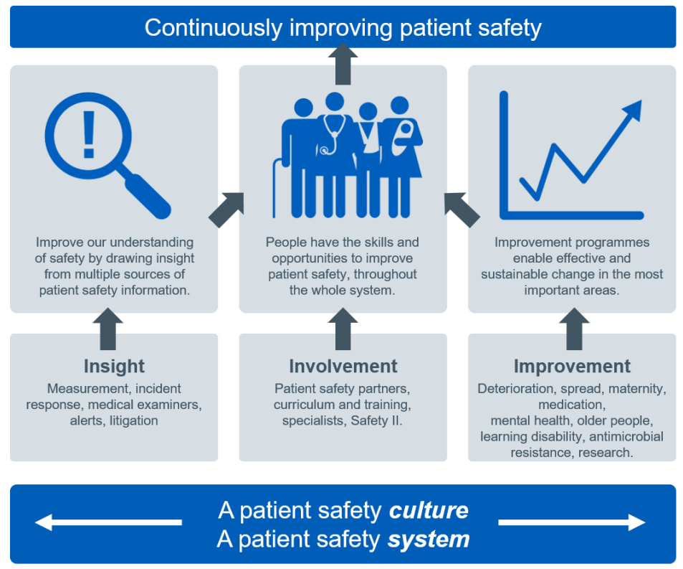
NHSE approach to Patient Safety
National Patient Safety Strategy 2019
Safety vision to continuously improve patient safety, building on two foundations
  a patient safety culture
  a patient safety system
Three strategic aims will support the development of both:
  Insight
  Involvement
  Improvement
PSIRF information and resources: Insights and opinions & Tools, templates and examples

Slide 18
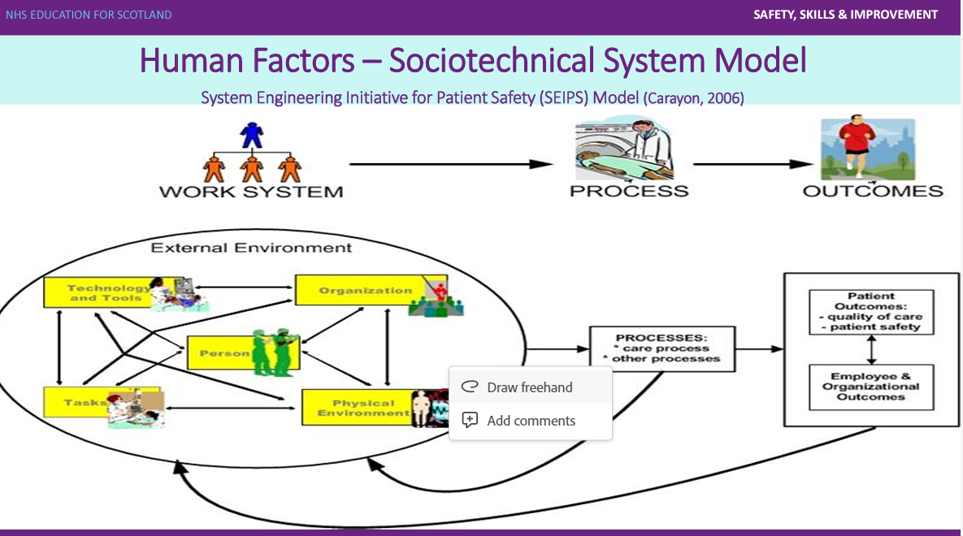
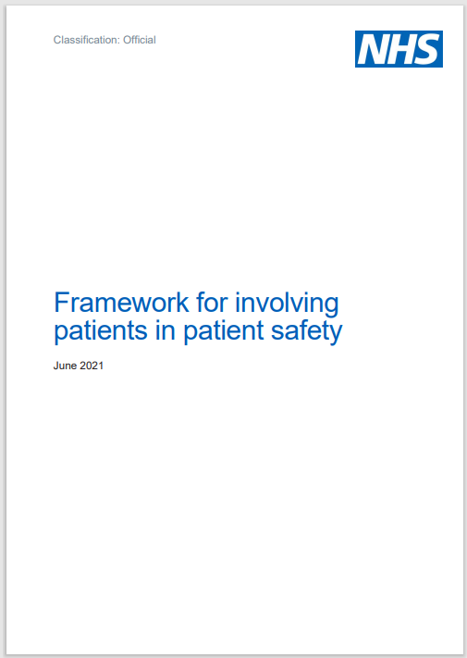

NHS Patient Safety Strategy: key actions
PSIRF – replacing the SI framework
  Understand the factors that have contributed to an incident
  Lessons are learned
  And acted upon for improvement
  Involving patients, families and staff meaningfully
Patient Safety Partners & patient engagement
LFPSE, updated incident reporting system
AHSN/HINs delivering elements of the NHSE strategy

Slide 19
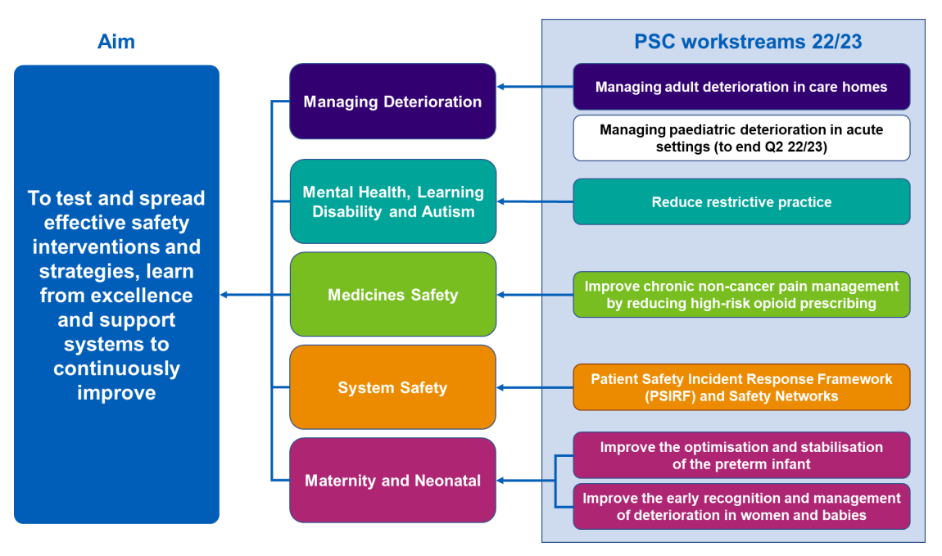
AHSN/HIN safety improvement programmes

Slide 20
US CMS Structural Measure vis-à-vis
Patient Safety Learning’s Standards
5 Domains
Leadership Commitment to Eliminating Preventable Harm
Strategic Planning & Organisational Policy
Culture of Safety & Learning Health System
Accountability & Transparency
Patient & Family Engagement
7 Foundations; 26 Aims; 144 Standards
Strong alignment: our Foundations, Aims & Standards incorporate the requirements
of the CMS framework...
Patient Safety Learning Standards are greater in scope & more comprehensive

Slide 21
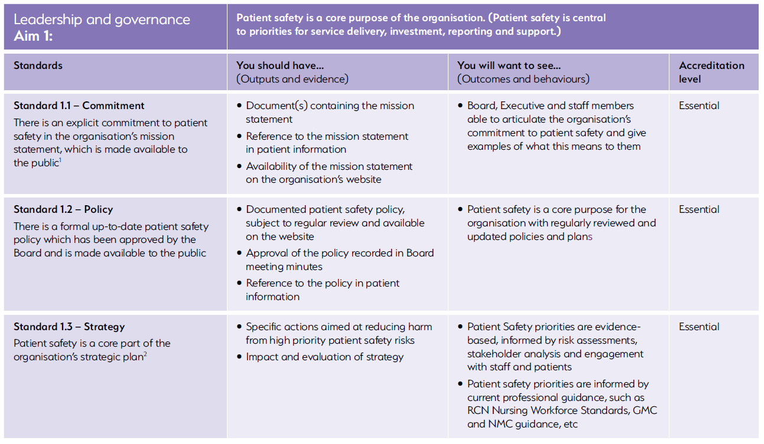
‘Unique patient safety standards: a world first
To help organisations establish defined safety aims / goals & demonstrate achievement against:
  Evidence-based outputs
  Outcomes and behaviours
Based on 20 years’ research
  including learning from inquiries, policy &
  good practice UK & internationally
Developed in partnership with specialists
& practitioners
  quality assured with ‘real world’ practicality

Slide 22
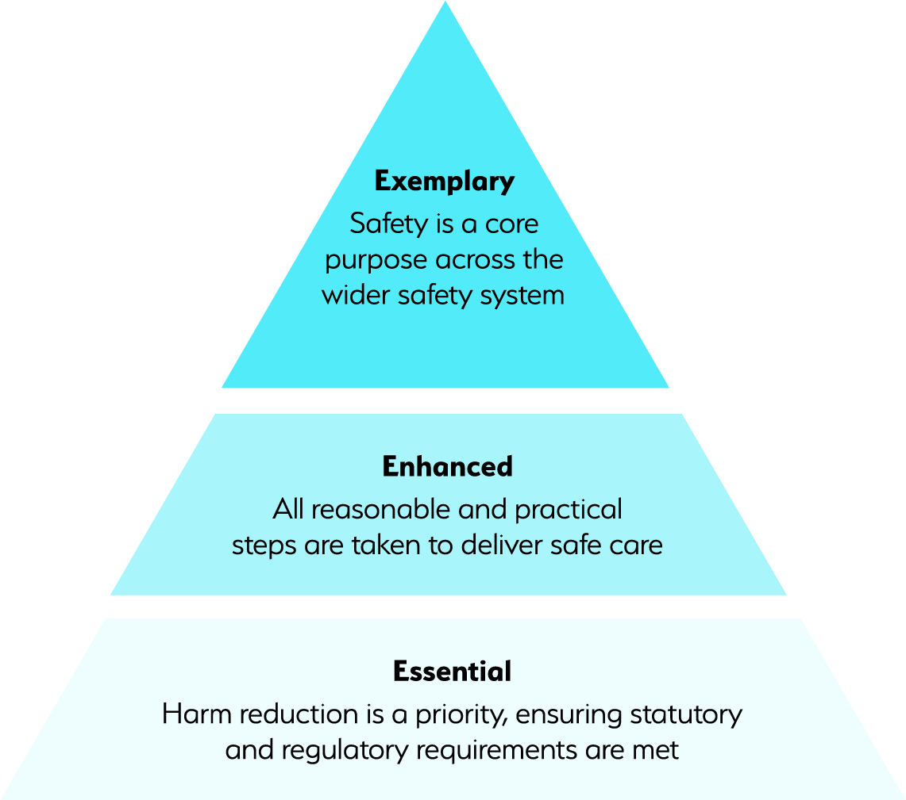
Assessment of safety culture and performance
High level organisational diagnostic ‘Snapshot’
Full deep-dive assessment of each of the 7 Foundations
Enables organisations to evaluate their performance &
delivery
  Baseline self-assessment
  On-going review to evidence improvement and impact
Informs regulatory assessment
Potential to extend into formal accreditation process (wip)

Slide 23
Agenda
Patient Safety Learning
  who are we & what do we do
Patient safety: the problem and impact
Why does avoidable harm persist?
What are healthcare leaders doing to address avoidable harm?
How Patient Safety Learning is contributing to safer care
PSIRF and NI SAI replacement
Reflective questions

Slide 24

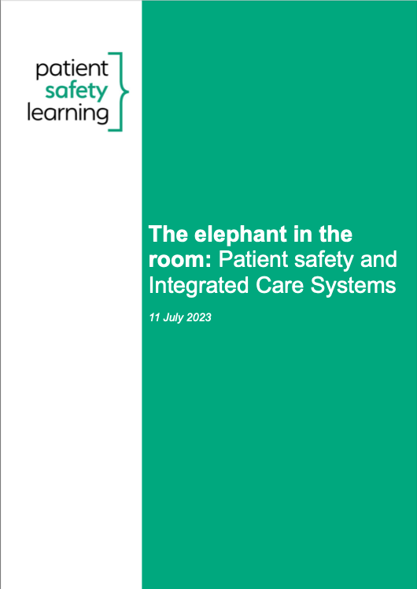
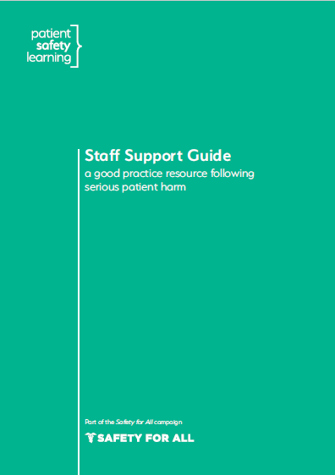
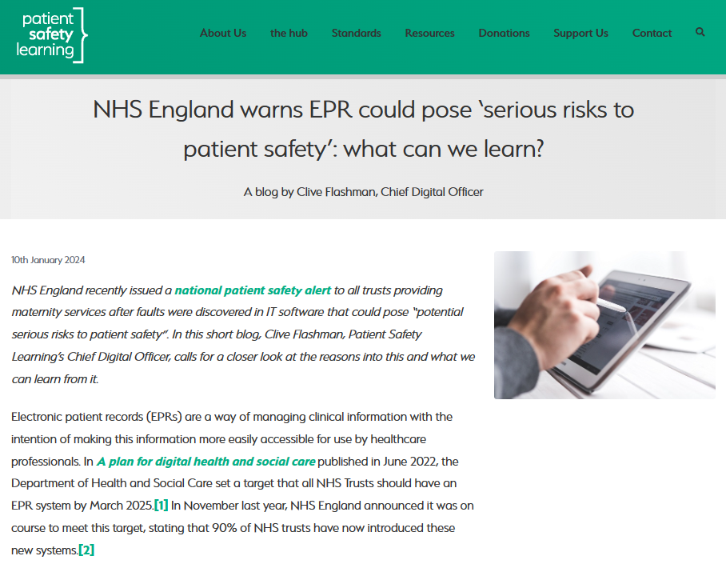
Policy, research, reports and guidance
Policy blogs and Staff Support Guide

Slide 25
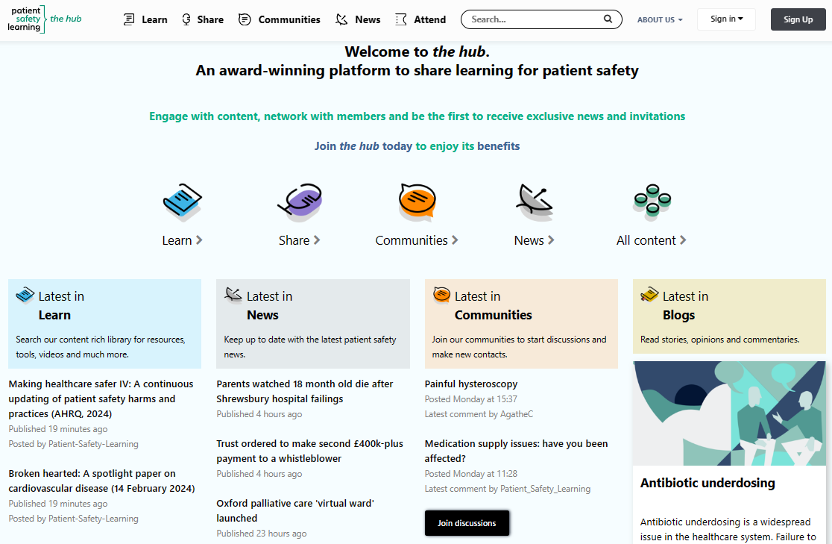
The world’s largest knowledge repository for patient safety– the hub (www.pslhub.org)
Sharing knowledge for learning and action
Publishing and promoting high quality content that can be shared to improve patient safety
Promoting patient safety good practice and policy
Promoting the voice of the ‘patient safety front line’
The home of patient safety networks
Its free!

Slide 26
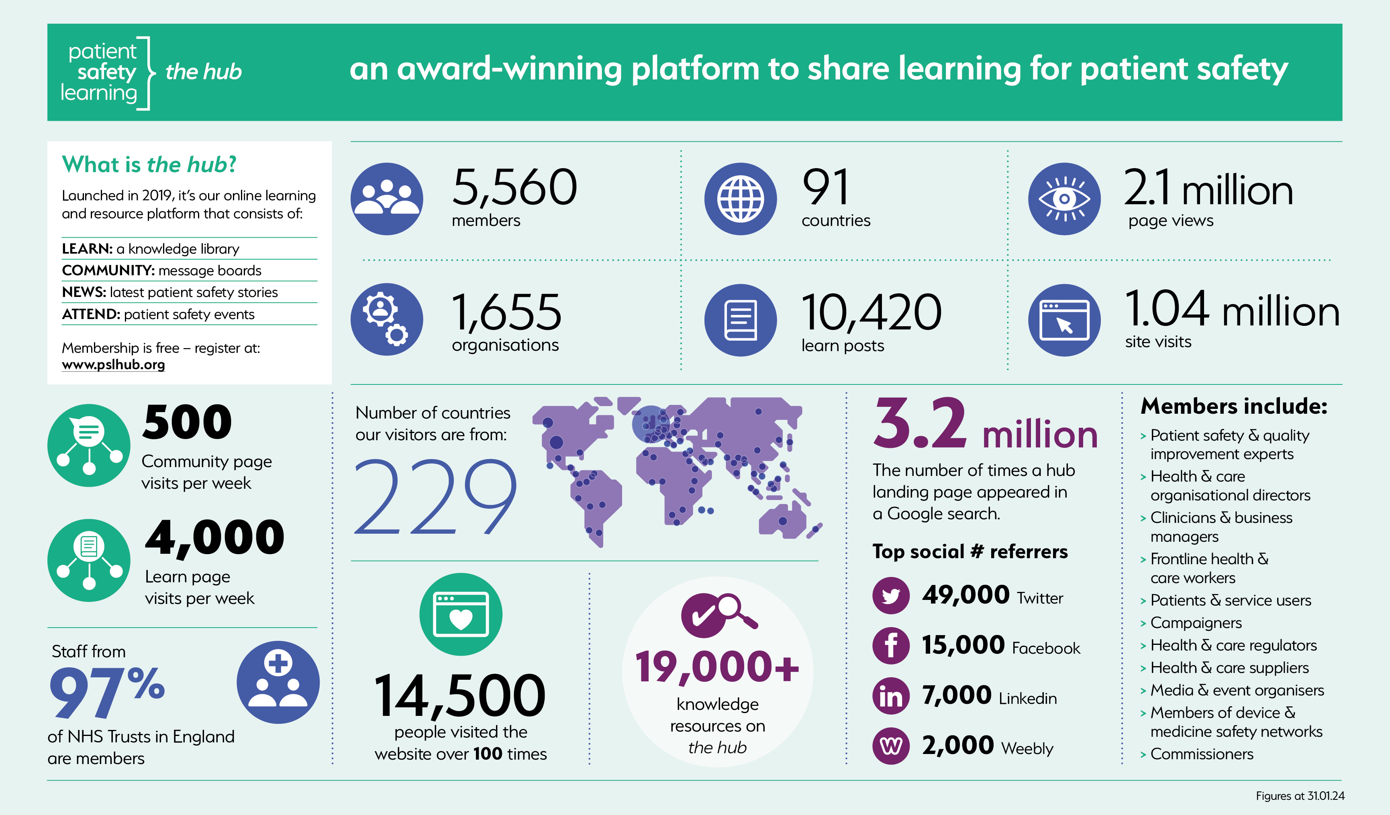

Slide 27





Patient Safety Networks
Informal voluntary networks created
by & for staff working in patient safety
Weekly drop-in sessions with
guest speakers
Information & peer support
Dedicated private space for discussions & sharing resources on the hub
Helping to develop & strengthen
an open & fair safety culture
Free and open to all in the UK
www.pslhub.org

Slide 28
Agenda
Patient Safety Learning
  who are we & what do we do
Patient safety: the problem and impact
Why does avoidable harm persist?
What are healthcare leaders doing to address avoidable harm?
How Patient Safety Learning is contributing to safer care
PSIRF and NI SAI replacement
Reflective questions

Slide 29
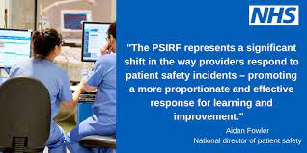
Patient Safety Incident Response Framework (PSIRF)
Four pillars:
  Compassionate engagement and involvement of those affected by patient safety incidents
  Application of a range of system-based approaches to learning from patient safety incidents
  Considered and proportionate responses to patient safety incidents
  Supportive oversight focused on strengthening responses system functioning and improvement
NHS England Patient Safety Incident Response Framework Resources

Slide 30
PSIRF Opportunities
PSIRF Challenges
PSIRF as an organisational development intervention:
  Just culture
  Whole organisation focus
  Not just the PS team
  Aligned to quality improvement
  Compassionate patient and family engagement
National requirements for PSII
  Proportionate & flexible local approaches
For learning
  Within teams, organisations, systems
  Learning leading to action, improvement & reduction in avoidable harm
  System wide
Need for engaged and supportive leaders
Significant training implications in the application of new tools and methods
Patient engagement
  Training and culture change
  It’s not easy
Criteria for local PSII and use of HF informed tools
  Accimaps, After Action Review etc
How to capture systems learning for dissemination and wider application

Slide 31
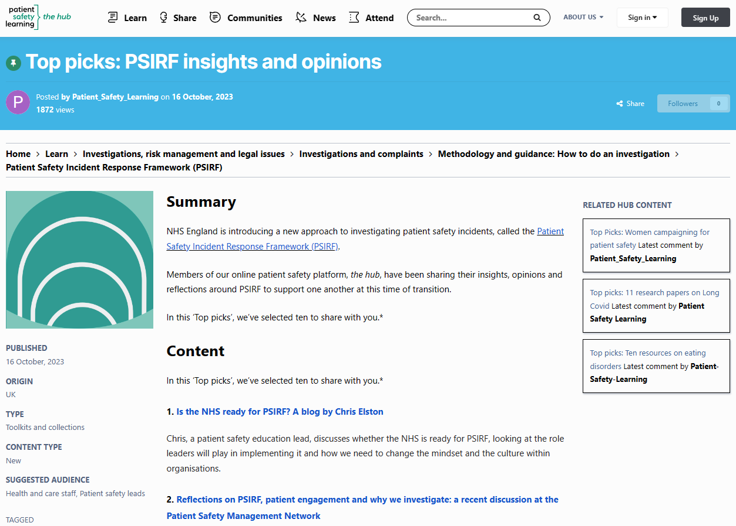
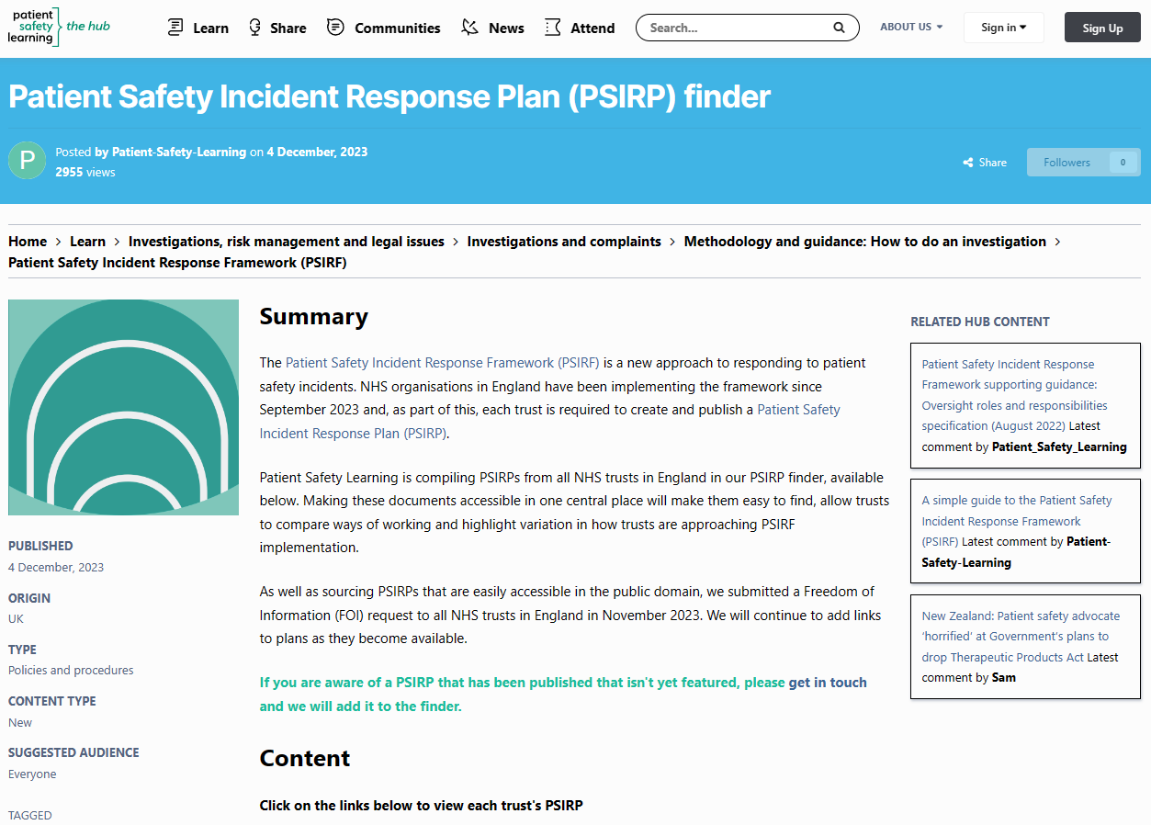
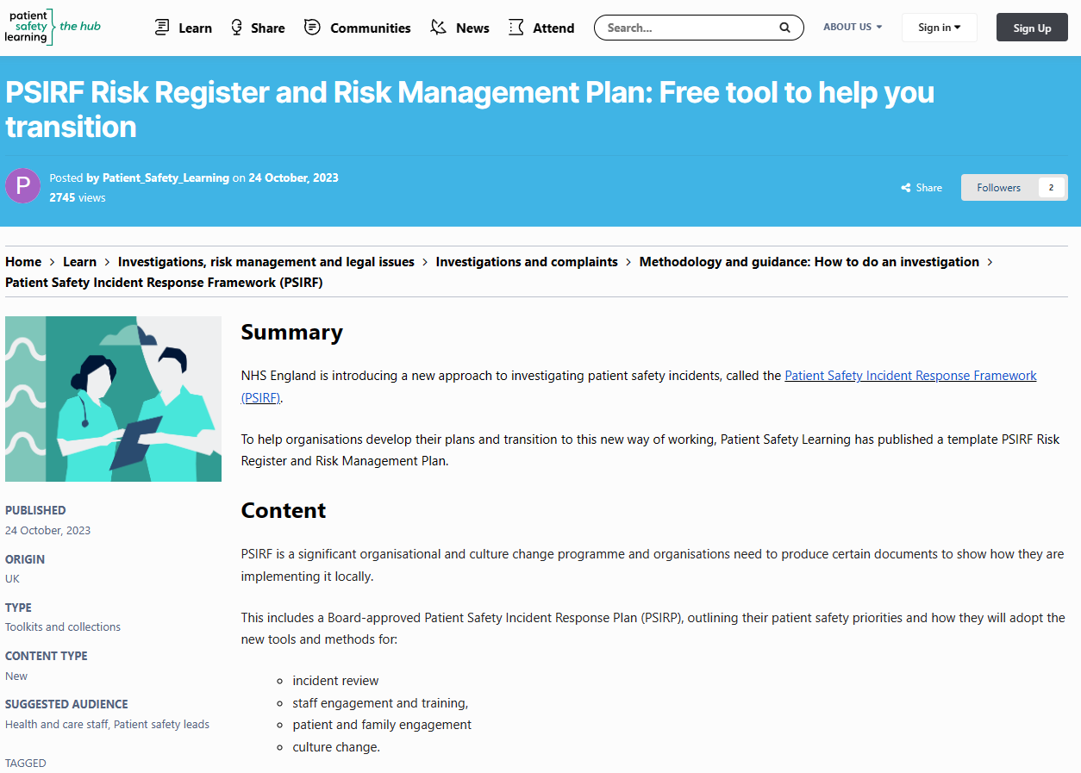
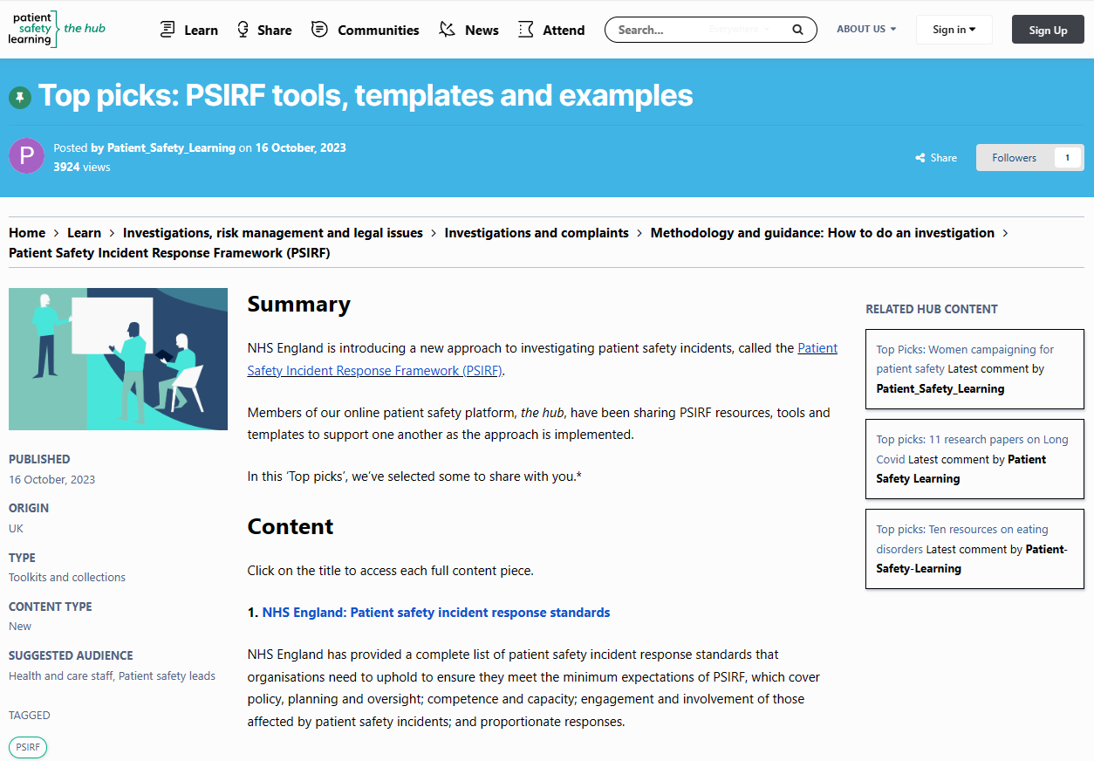

Slide 32
Agenda
Patient Safety Learning
  who are we & what do we do
Patient safety: the problem and impact
Why does avoidable harm persist?
What are healthcare leaders doing to address avoidable harm?
How Patient Safety Learning is contributing to safer care
PSIRF and NI SAI replacement
Systems safety: reflective questions

Slide 33
Do you have the foundations for safer care? | What else should you consider? | Can you be certain?
Do you have the right leadership & governance to deliver safe care? | Not just commitment, strategies & processes, but behaviours too. | How do you know?
Does your organisational culture promote & support patient and staff safety? | Or is your ambition undermined by blame & fear? | Would your staff agree?
Do you share & apply learning across your organisation? | Not just learning from incidents of unsafe care, but how to apply good practice to mitigate risk. | Has it changed things?
Are you professionalising patient safety? | Are your expert staff using ‘What Good Looks Like’ to design & deliver safer care? | If not, why not?
Are your patients & their families actively engaged in safety? | Are patients & their families involved in shared decision-making and do their insights inform the design & delivery of improvements, when things go wrong? | Have you asked whether they feel encouraged to do this?
Do you effectively measure & monitor your safety performance? | Is there sufficient emphasis on proactive risk assessment & quality improvement, rather than focusing overly on retrospective learning from harm? | Do you feel confident in your ability to do so?
Are your patient safety services safe? | Do you have the right conditions & systems to enable your staff to deliver safe care? | How do you assure yourselves?

Slide 34
Framework for Learning and Improvement
Redesign of the Serious Adverse Incident Procedure
Professor Lourda Geoghegan
& Mr Kieran McAteer

Slide 35
Introduction
Clear evidence base of need for change
More streamlined and simpler approach
focused on learning
Aim to develop and test new proposals
with due pace with an agile and iterative
approach
Programme outputs – including
Framework; Methodologies; Guidance
Managed transition

Slide 36





Evidence Base for Change
Recommendations from Inquiries – IHRD & INI
RQIA Review
Builds on Co-Production & Involvement
International Developments

Slide 37
Challenges Current SAI Procedure
Too process driven
Time taken to complete investigations
Resource intensive
Lacks flexibility
Engagement with patients, service users and families not always optimal
Limited evidence of improvement
Sometimes conflated with other processes
Learning not always system based
Staff not always supported
Language

Slide 38


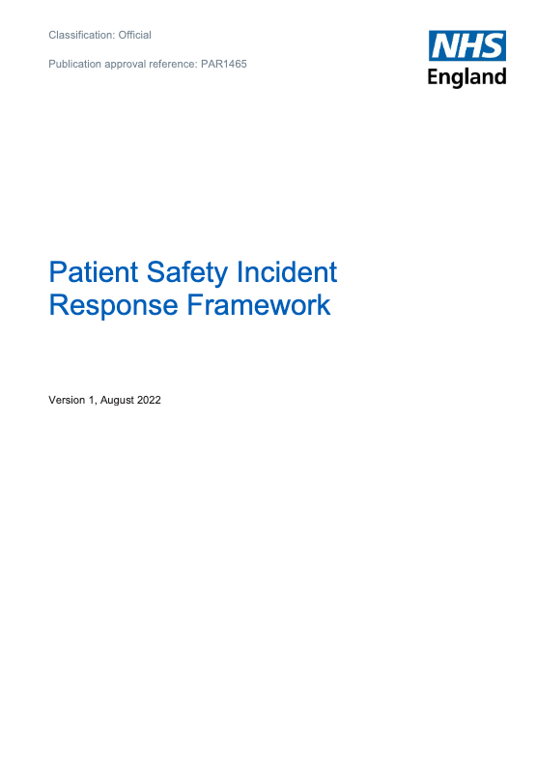


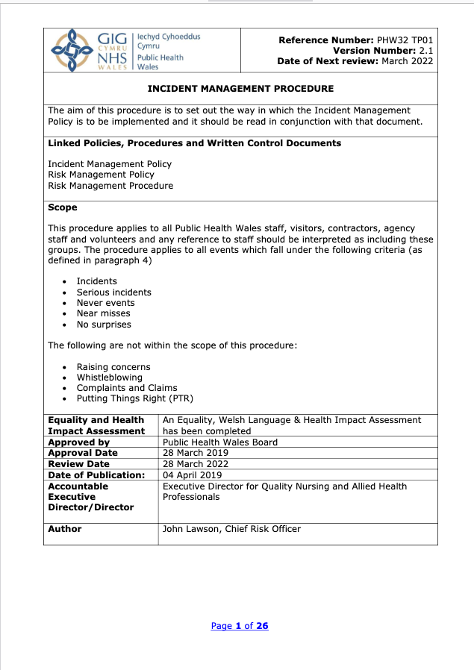

What are others doing?
How are others learning?
England
Scotland
Wales
Ireland
Australia
New Zealand
Canada

Slide 39
Developments so far
Project working arrangements in place
Family members & carers confirmed
High level themes to guide and underpin
Programme of work agreed
Stakeholder & public engagement started – HSC and other
Draft framework in development
Associated standards in development
Intention – clarity, terminology, systems

Slide 40
Benefits of new approach
Service users and their families/carers central
Staff support and involvement central
Proportionate response to Patient Safety Events
Utilising HSC resources more effectively
Streamlined process
System based approach to learning
Rebalancing of oversight & assurance roles
Supports and requires a cultural shift

Slide 41
Key next stages
Service user and carer involvement
Further staff engagement
Engage with other stakeholders
Interim programme deliverables
Prototype and refine
Develop oversight and assurance guide
Managing transition
Scope training needs

Slide 42
Q&A and Discussion
Facilitator – Majella McCloskey

Slide 43
Question 1
Initial views and comments?
Reflect and discuss at tables and provide feedback – key reflection per table
Notes:
Suggest Majella lead - 5 mins

Slide 44


Slide 45
Question 2
What are the main enablers to developing a ‘system-based’ approach across HSC to learning and improving following patient safety events?
How might these be supported?

Slide 47
Question 3
What are the main barriers to developing a ‘system-based’ approach across HSC to learning and improving following patient safety events?
How might these be addressed?

