Slide 1
Breakout 4
Addressing Inequalities in Patient Safety
Graham Mockler – Professional Standards Authority
Prof Owen Barr – Ulster University

Slide 2
Health Inequalities and Patient Safety
Graham Mockler
Director of Regulation and Accreditation

Slide 3
About the Professional Standards Authority
Oversees the work of 10 regulators of health and care professionals
Fitness to practise appeals
Performance review
Accredited Registers programme for non-statutorily regulated practitioners
Policy advice and guidance
Research
Literature reviews
Qualitative research
Notes:
The Professional Standards Authority (PSA) is a UK-wide body that oversees the work of 10 regulators of health and care professionals. These regulators include the Pharmaceutical Society of Northern Ireland, GMC, NMC, GDC etc. We do not have a role in regulating places or systems. Our focus is on public protection.
Our work can be split into key areas:
Assessing regulators against our Standards of Good Regulation on an annual basis to ensure they are regulating effectively in the public interest. We have 18 Standards, one of which focuses on equality, diversity and inclusion, and the regulators’ work to identify and address unfairness and inequalities.
Reviewing the outcomes of all final fitness to practise hearings across the 10 regulators to ensure the outcomes of these are sufficient for public protection. We can refer cases to the courts if we do not consider the outcomes to be sufficient.
We accredit registers of unregulated health and care practitioners through our Accredited Registers programme. There are currently 29 registers within the programme, covering 130,000 practitioners across a wide range of occupations. Large proportion work in mental health, particularly counselling and psychotherapy. Can cover any occupation that isn’t regulated.
We also have a policy function that undertakes research and provides advice to drive improvements in regulation and regulatory practice.

Slide 4
Safer care for all – overview
Four main themes:
Tackling inequalities
Regulating for new risks
Facing up to the workforce crisis
Accountability, fear and public safety
Notes:
It was in the context of our policy work that we produced Safer Care for All, a review of the current state of professional health and care regulation in the UK across four key themes: tackling inequalities; regulating for new risks; facing up to the workforce crisis; and accountability, fear and public safety.
The idea of SCfA was to look at some of the biggest challenges affecting the quality and safety of health and social care across the UK. While it had a focus on professional regulation given our role, it looked at the system more widely.
Our report illustrates how fragmented the landscape we are operating in is – health, social care, and four countries, each with complex patient and public safety mechanisms spanning numerous different bodies. For a long time, individual organisations with different and specific remits have been expected to work together to address workforce and patient safety issues. This approach could be said to be structurally flawed as there is generally no accountability for joint working and collaboration. Differing organisational priorities also present significant barriers. Everyone understandably looks at the problem through the lens of their own remit, but no one has the overview.
This applies to inquiries too. The repeated findings of multiple inquiries over many years exposes the lack of any mechanism to identify themes and learnings across different inquiries, and to ensure that recommendations are acted upon in a coherent way. This problem is exacerbated by the variation in how inquiries and reviews, are set up and managed. Typically, governments deal with individual inquiry reports separately. This means that we lack a coordinated response that could more effectively prevent future harm.

Slide 5
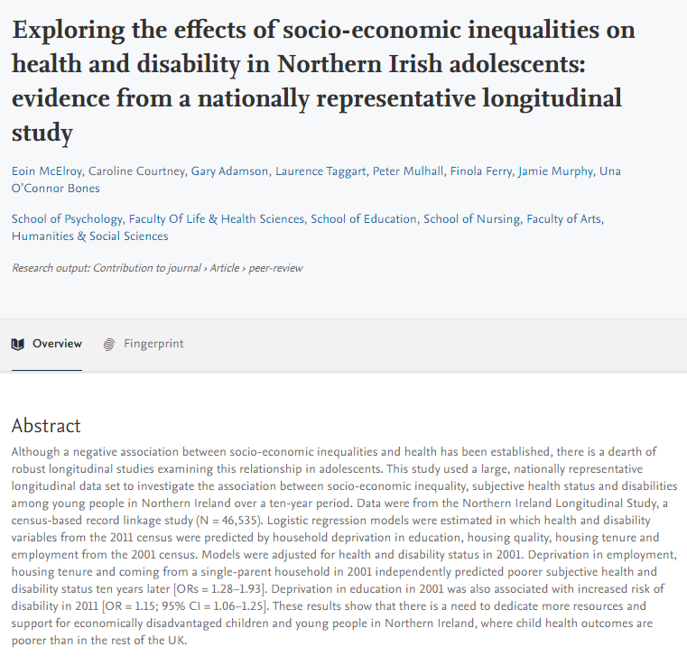
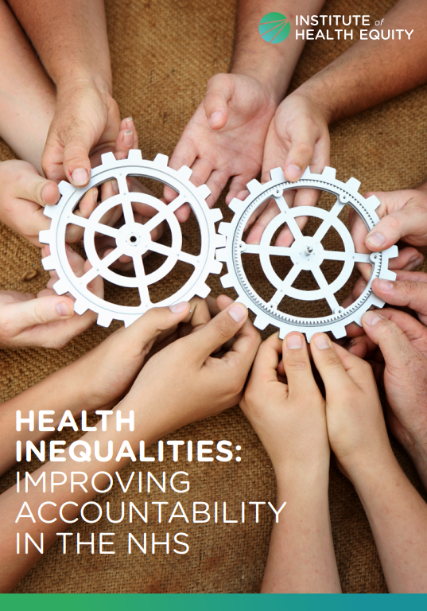
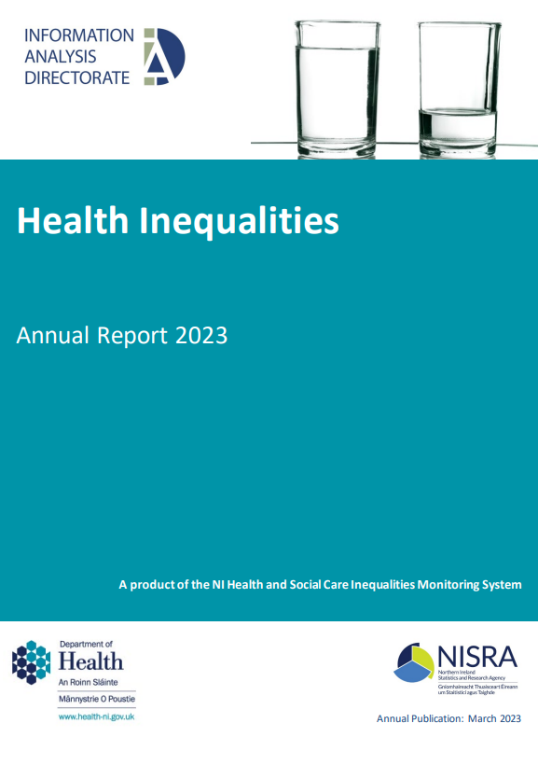
Safer Care for all – inquiries and inequalities
Notes:
There has been significant research into healthcare inequalities, affecting various groups of individuals within the population. While the specifics of inequalities may vary, this applies to every country and region in the UK. We have known about some of these inequalities for years and years, while others have more recently come to light. Many major failures of care and examples of abuse and neglect across the UK have had a particular impact on those who share characteristics, including women, older people and those with disabilities.
Despite progress being made in some areas, can we say that a coordinated approach is being taken across the system to address this in the most effective way possible? There are so many players in the system, working at different levels and with different focuses, that effective coordination and collaboration can be difficult.

Slide 6
Healthcare inequalities – the role of regulation
Education and training
CPD
Fitness to practise
Workplace culture
Responsibilities across a range of organisations
Notes:
To be able to fully understand and tackle healthcare inequalities, we need to look across the system. In a system with so many players, this is particularly complex. I have pulled some key areas from the perspective of regulating individuals, but I think it’s fair to say that for each area, there multiple players involved, both locally and nationally.
The first is education and training.
Are healthcare professionals adequately trained to treat the variety of patients they will see? Will a doctor or nurse be able to treat two patients from different demographics presenting with the same condition to an equal standard based on their training?
An important consideration in education and training at all levels is the prevention and removal of assumptions and biases. We see almost weekly reports in the news of women who have had to fight for years for a diagnosis because healthcare professionals didn’t believe there was anything wrong. Is this due to a lack of training on issues such as endometriosis, assumptions and biases about women presenting to healthcare, or a mix of both?
Another linked area for regulators to consider is continuing professional development. Are regulators requiring registrants to keep their practice up to date in a way that most effectively protects all patients? Given that this is interlinked with training offered and delivered at a local level, how are healthcare providers ensuring that the training offered to staff meets the needs of their local demographic? A whole system approach to reducing inequalities needs both national and local implementation to work.
We know from regulators’ data that in some professions, certain demographics (for example overseas trained registrants) are more likely to be referred to them for fitness to practise investigations. There’s a multitude of factors relevant here, but in relation to patient safety, are groups who are overrepresented in fitness to practise processes being provided the same opportunities and support at a local level as other colleagues? Are healthcare professionals recruited from overseas provided with adequate induction and training to enable them to thrive in the local healthcare system? And to adapt to new cultures? What do we know about discrimination they face from patients and colleagues?
Going further, we know that a negative workplace culture can negatively impact on patient care. Analysis of the NHS Staff Survey suggests that, in organisations where staff experience discrimination or harassment from colleagues, or perceive unequal opportunities for career progression or promotion, patients are less likely to be satisfied. Our research looking at the impact of breaches of sexual boundaries between colleagues supports this. It found that workplace cultures where staff feel uncomfortable or bullied by colleagues are likely to pose risks for patients. Recent reports into the prevalence of sexual misconduct against healthcare professionals, both by patients and colleagues, including those by the Working Party on Sexual Misconduct in Surgery and Surviving in Scrubs, is utterly shocking. Can we expect staff to provide the best care possible to patients when they are facing these types of issues and they themselves don’t feel safe at work?
There are multiple organisations involved at local and national levels with responsibility for or influence in these areas, all of which can contribute to healthcare inequalities. Are we maximising the joint power of these organisations in trying to reduce inequalities?

Slide 7
Complaints handling
Data – do we know who is and isn’t complaining?
What are the barriers to complaining?
Lost opportunities for / delays to improvement?
Patient voice
Notes:
Following from our Safer Care for All report, one area we have been looking at is complaints handling. We think this has particular importance and are very interested to see NIPSO’s work to transform the complaints system. In our report, we found that there is a lot we still do not know about how inequalities affect complaints mechanisms when care has gone wrong – or indeed what this could tell us about biases in care itself. We also do not fully know the barriers to raising complaints.
While we know a reasonable amount about health inequalities, we know relatively little about those complaining about poor care and the conduct of healthcare professionals. The complaints landscape is complex, and it wouldn’t be surprising if this had a different impact on different groups when they are considering or trying to raise complaints.
With unclear data on who is complaining, we may be missing a part of the picture of health inequalities and the ability to address these. There is therefore a risk that we don’t fully know the problems affecting different groups of patients and service users. And if we don’t know this, do we know whether there is a disproportionate impact of harm, particularly arising from major failures of care, on groups of patients who share characteristics?
Looking at this in terms of inquiries across the UK, one example we highlight in Safer Care for All is the Ockenden Report in England into avoidable harm and death in maternity services. As with other failings of care, families were forced to campaign for years to have their concerns addressed. On the back of other, similar, findings the inquiry raises a question about whether the voices of patients, and particularly women, are listened to both in terms of the care they receive and when they are making complaints. We see it time and again with many inquiries – it takes concerted effort for committed individuals, often who have suffered significant harm or loss, to push for their concerns to be heard. And it may only be those who can successfully navigate a complex system, and that have the skills and resources to do so, that are ultimately able to push this forward. Even when issues are fully investigated through inquiries, there have been years where patient safety has been compromised when issues could have been addressed earlier.
Inquiries through their nature focus on substandard care that affects particular groups. But what do we know about intersectionality and how those sharing multiple characteristics are put to even greater harm in these instances of poor care? This is another level of complexity that we may know less about, particularly the compounding effect of multiple characteristics.
We need to properly understand who is affected by failures of care and what more can be done to mitigate the risks for particular groups. The patient and service user voice needs to be strengthened and amplified; and proper partnership with patients and service users must be built into health and care provision and regulation.
Ensuring that diverse patient voices are heard is crucial in improving the safety and quality of care. Are we confident that processes to feed into healthcare design and delivery, and complaints processes are accessible to all?
There is a risk that if we don’t know who is and importantly, who isn’t complaining, we may tailor improvements based on the visible rather than what we are not seeing. This then has the potential to widen healthcare inequalities by driving improvements for groups that are visible in complaints and other processes.

Slide 8
Solutions?
Oversight of inquiries
Improving complaints data
Reducing barriers to complaints
Collaboration and learning from success
Whole system approach
Notes:
So, how can we resolve some of these issues so that we don’t end up with more inquiries saying the same thing? Putting wider, societal issues to one side…
We have proposed that there needs to be a function with broad responsibility for identifying, monitoring, reporting, and advising on ways of addressing patient and service user risks. There needs to be some role that has oversight to ensure recommendations from inquiries are acted upon and outcomes monitored. This can draw together themes from multiple inquiries to share learning and have greater impact. There should be a specific focus in this remit on inequalities.
We also think we need to improve complaints data so that we know where and how to address issues. This is something that I don’t know that anyone has resolved – it is very difficult to get demographic data on complainants as it’s yet another thing that we’re asking people for. Ensuring that there’s clarity on why the information is collected and the importance of doing so is a helpful part of driving up data collection, but alone this won’t resolve the issue. I’d be interested to hear any work that has been done and any learning or successes that could be shared in relation to gathering data on complainants.
Reducing barriers to complaints is key if we want to be fully informed of issues and be able to address them, and the inequalities that persist within. This is true at all stages of complaints. Thinking about just one barrier – the accessibility of documentation – there has been recent research undertaken into the experiences of witnesses in fitness to practise procedures (Witness to Harm). One element this looked at was the reading age of regulators’ documentation which highlighted that information may not be fully accessible for those wishing to raise complaints. Having accessible complaints mechanisms is an important element of ensuring we know of issues affecting patients.
Much is being said about a trauma informed approach currently – this is a crucial element to consider when patients have been harmed as we know that retelling accounts of harm retraumatises victims. But it requires the system to come together to enable a trauma informed approach – is it possible within the current system for victims to tell story once only? Or at the very least have one main point of contact for the duration of their complaint?
Thinking further about a whole system approach. How do we extend that to reducing inequalities? Is it possible to combine system and professional responsibilities to close the gaps? Of those directly working in services, those with responsibility for training healthcare professionals, and those involved in oversight and regulation. Are we maximising opportunities to take learning from what we know about healthcare inequalities and themes from patient safety incidents to properly train and equip our healthcare practitioners to meet and address these challenges? Are there structures in place at local and national level to support healthcare professionals on the ground to have the maximum impact in terms of reducing inequalities and ensuring issues raised through inquiries don’t reoccur? Can we improve collaboration to more effectively address inequalities?
Have we, in fact, fully bottomed out the role and responsibility of individual healthcare professionals in tackling discrimination and health inequalities? And are they supported to provide a service that recognises and meets the specific needs of different groups – through training, regulation and support at a local level?
Looking more widely at collaboration and sharing practice, what can we learn from other countries? For example, in New Zealand, the Medical Council has taken a proactive approach with its requirements for doctors around ‘cultural safety’, intended to address the well-documented poorer health outcomes for Maori patients. The requirements ask doctors to consider: ‘Challenging the cultural bias of individual colleagues or systemic bias within health care services, which may contribute to poor health outcomes for patients of different cultures’ in their practice. Can we adapt such approaches for our own health inequalities?
This obviously all comes in the context of an incredibly stretched healthcare system. And we can’t resolve everything at once. But there are successes, and there is great work being done. I’d be really interested to hear some of those successes in the discussion.

Slide 9
Thank you
Link:
Safer Care for All: https://www.professionalstandards.org.uk/docs/default-source/publications/thought-paper/safer-care-for-all-solutions-from-professional-regulation-and-beyond.pdf?sfvrsn=9364b20_7
graham.mockler@professionalstandards.org.uk

Slide 11
Health Inequalities and people with learning disabilities: Equity of access – Equity of outcome Professor Owen Barr

Slide 12
Focus of the presentation
The aim of the session is to highlight that some people are more at risk of poor outcomes than others. In a health system under pressure what do we know about people who might be vulnerable and what can we do to identify and protect people when they are vulnerable.
Which people using services may have their safety potentially at risk – what do we know about people experiencing vulnerability?
What does this look like, what is the impact on people (and their family members) we provide services to?
Do we have the right data to identify people when they may be vulnerable?
What do some potential solutions and good practice look like?

Slide 13
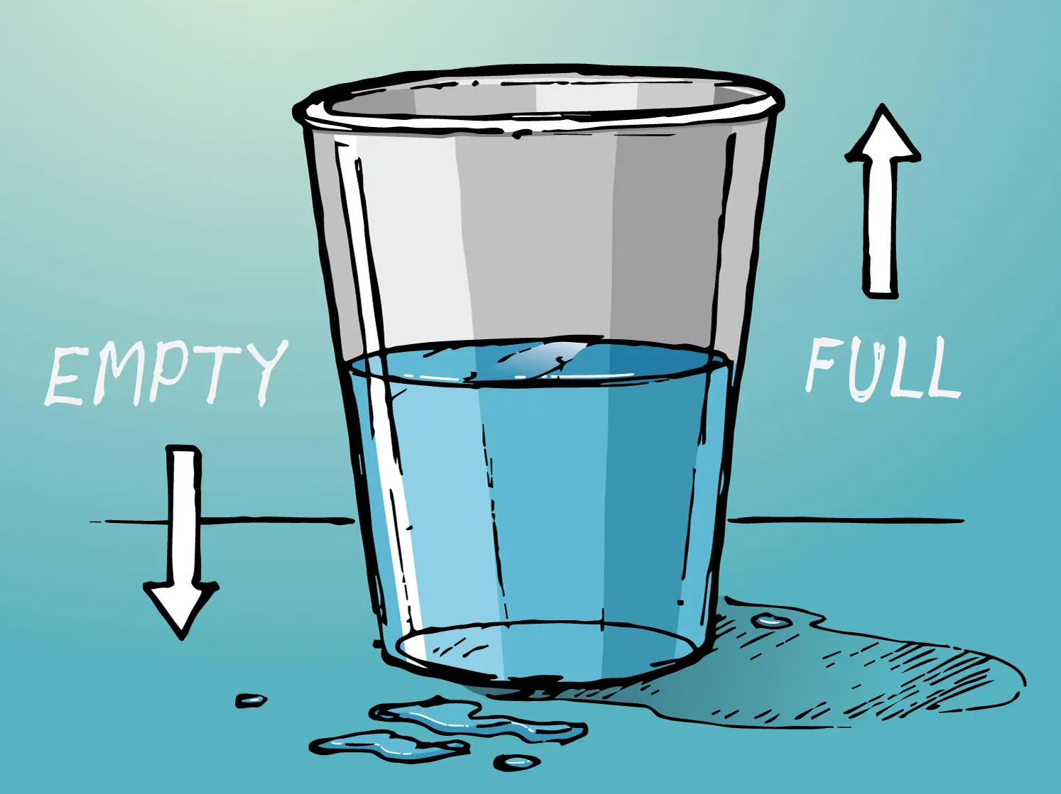

Slide 14
Glass half full…
Increased life expectancy among people with learning disabilities
Improved access to general health services
Changing patterns of mortality and morbidity for people with learning disabilities
Some local efforts to develop innovative approaches to support people with learning disabilities access general health care

Slide 15
Regional guidelines

Slide 16
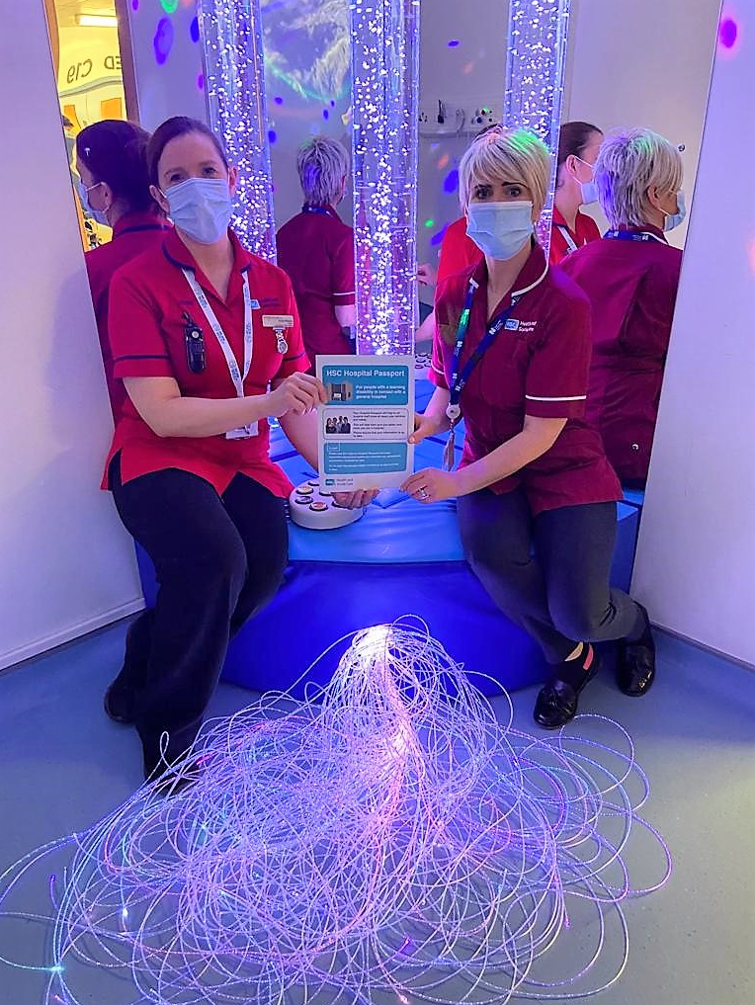
Some practical steps forward

Slide 17
An emphasis on reasonable adjustments

Slide 19
Consent for examination, treatment and care (DHSSPS 2003)

Slide 20
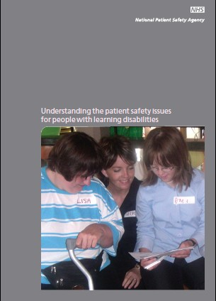
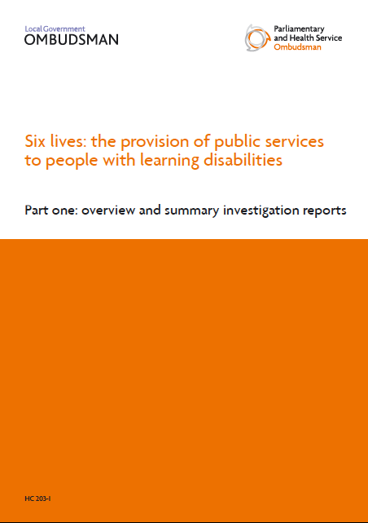
Progress but…wider picture

Slide 21
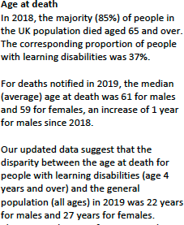
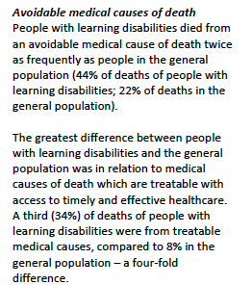

Slide 22
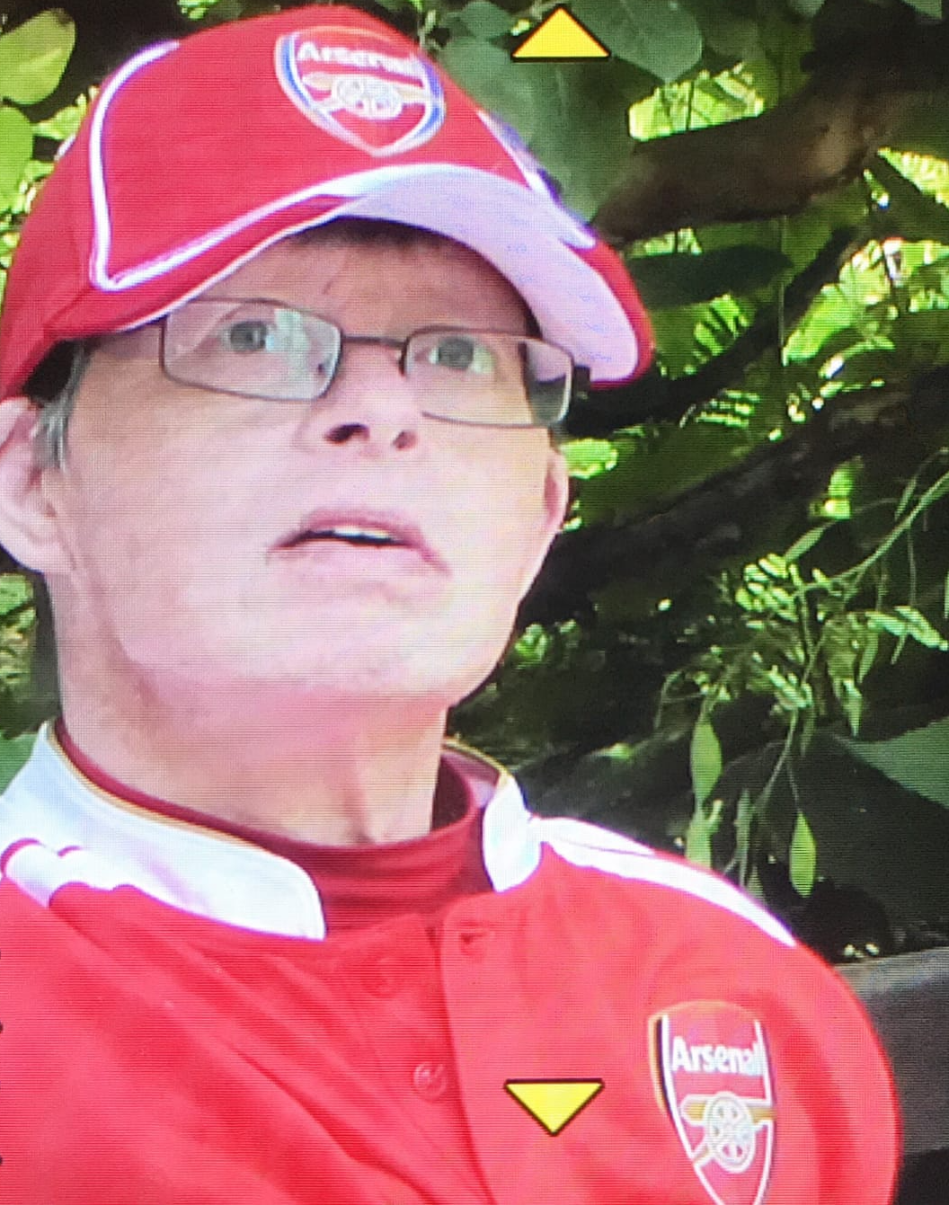

Slide 23
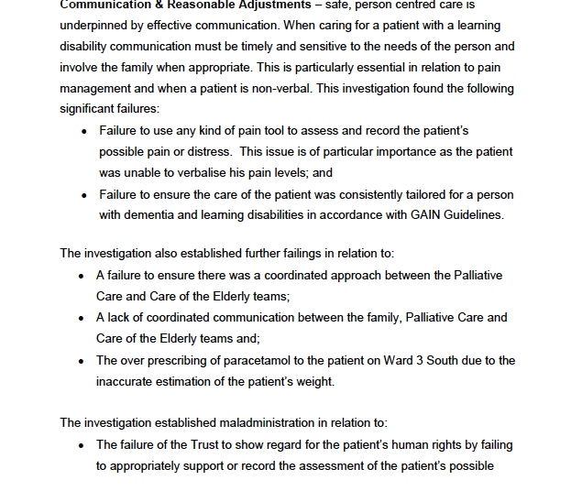
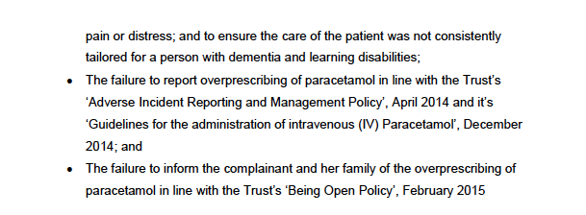

Slide 24
2016
2019
2021

Slide 25
Blind spots in services – do we have the right data

Slide 26
Some examples of blind spots…
We do not have any substantial population health data on people with learning disabilities using services in Northern Ireland
We have activity data from some services – but not outcome data
We do not know how many people with learning disabilities use general hospital services, when or why
We have repeated recommendations (GAIN 2010; RQIA 2014; RQIA 2018) to appoint Acute Liaison Nurse, but only one HSCT have any Acute Liaison Nurses

Slide 27
We have repeated recommendations to plan transition for young people to adult services from 14yrs of age, but still do not do this effectively
We have evidence of the failure to use HSCT Adverse incident processes to escalate poor care
We do not seem to be able to interrogate Severe Adverse Incident data focused on people with learning disabilities – across services
We have several NIPSO reports evidencing poor practice

Slide 28
Thoughts on moving forward

Slide 29
Q&A and Discussion
Facilitator – Dr Helga Sneddon

